Slide 1





Exploring Object-Oriented programming in game development
Members:
Srinivas Akhil Mallela
Likhitha Katakam
Vishal Prabhachandar

Slide 2
Agenda
Introduction
Analysis of Anti patterns in game development
1
3
2
4
Modern OO techniques in the gaming industry
Analysis of Object Oriented programming techniques

Slide 3

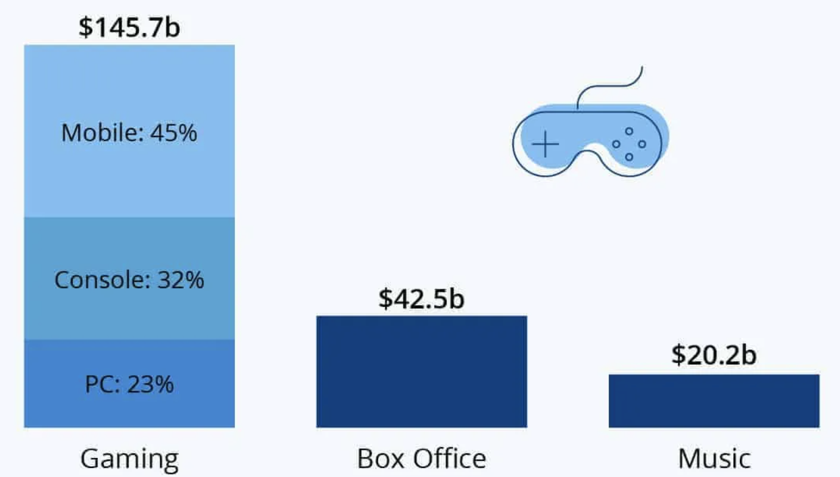


Current state of the gaming industry
Gaming and game development has been in the forefront of many breakthroughs and advancements. Being one of the top revenue generators in the entertainment industry, they have had a big impact in the software development world as well.

Slide 4
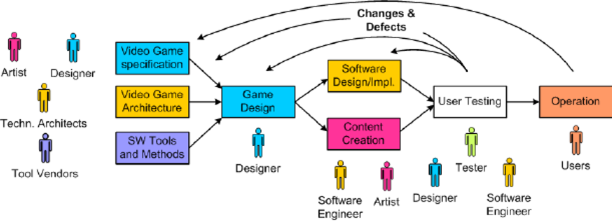
Motivation and reasoning
Multi-billion dollar industry
Customer facing applications
Object oriented principles and patterns
Game development combines control system, AI, sound and art, which makes them quite different from the traditional software development. However the practices followed to keep up with the tightly knit project plans are similar to software engineering techniques used commonly in the industry to maintain flexibility, increase maintainability, lower costs and improve design.

Slide 5
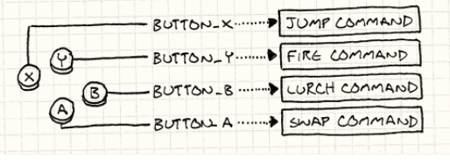

Command - Situation
Let’s consider the following two scenarios commonly found in games.
Configuring inputs Undo and Redo

Slide 6
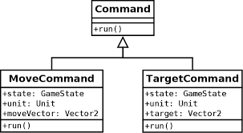
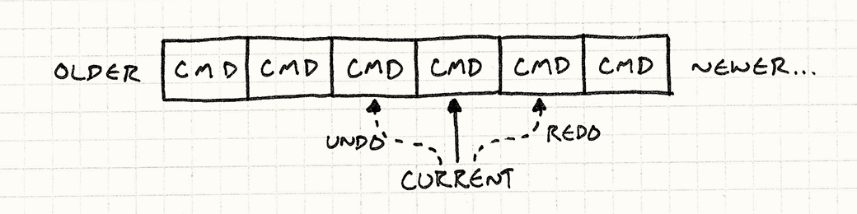
Command - Usage
We can create a base class which represents triggerable game commands, further create subclasses for each of the different game actions.
To undo, we need to remember the state and location of the last action. And subsequently, to redo, we execute the command again. We can keep a list of the actions executed in the data structure and support undo/redo through command pattern.

Slide 7
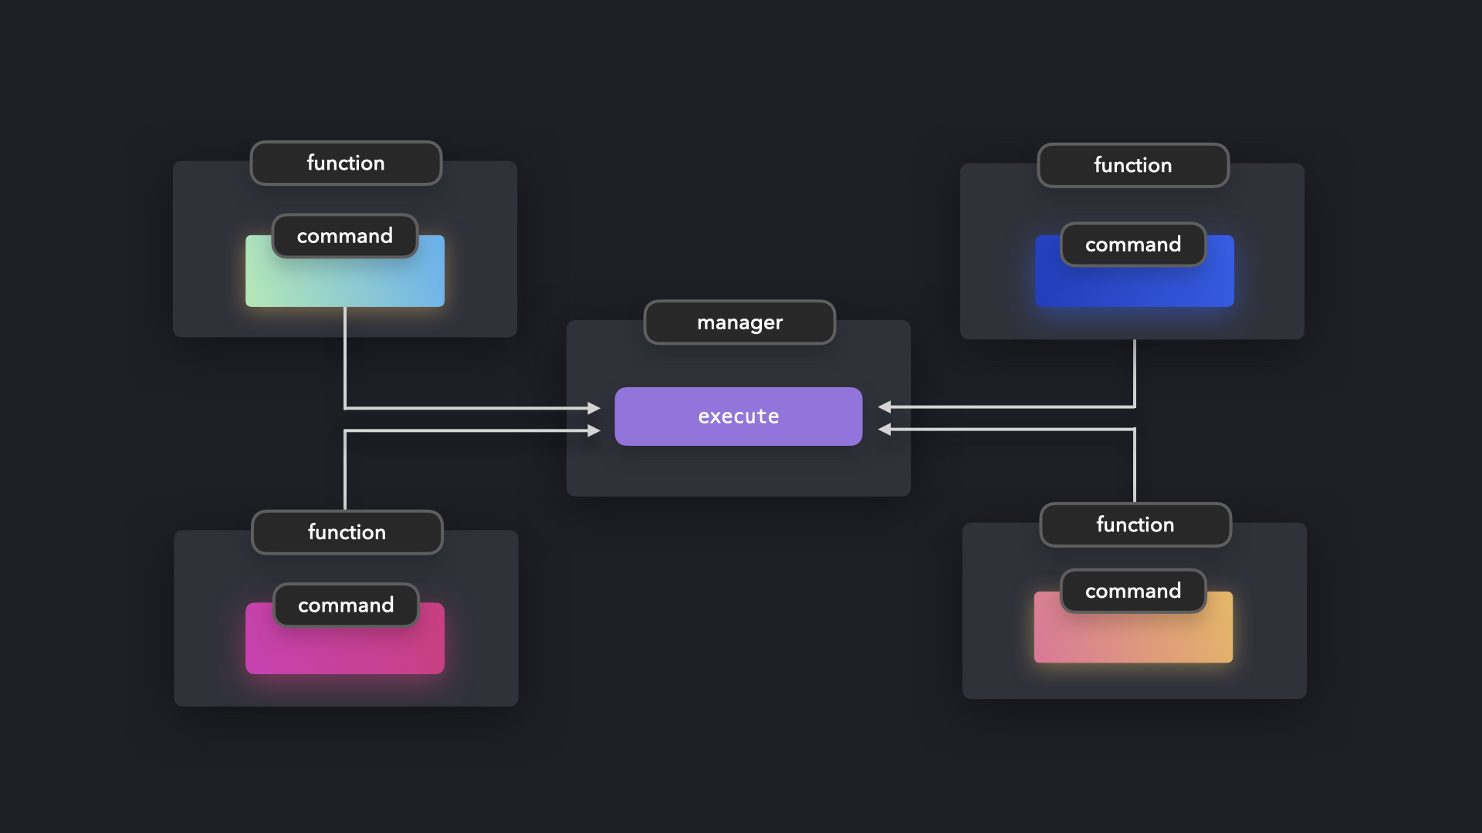


Command – Pitfalls
- There are a high number of classes and objects working together to achieve a goal. Application developers need to be careful developing these classes correctly.
- Every individual command is a ConcreteCommand class that increases the volume of classes for implementation and maintenance

Slide 8

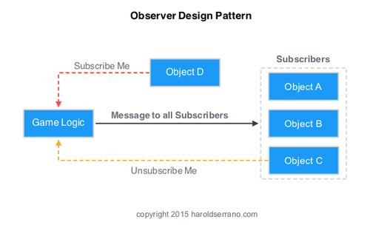
Observer - Situation
Consider a game where achievement badges are unlocked based on the different milestones completed. Coupling the achievement code into the gameplay code is not the proper way. As achievements are unlocked by different sorts of gameplay behaviors.
Observer pattern simplifies the case in that it allows objects to keep other objects informed about events occurring within a software system. It’s dynamic in that an object can choose to receive or not receive notifications at run-time. Here, the publisher is called the subject and the subscribers which listen to notifications are observers.

Slide 9
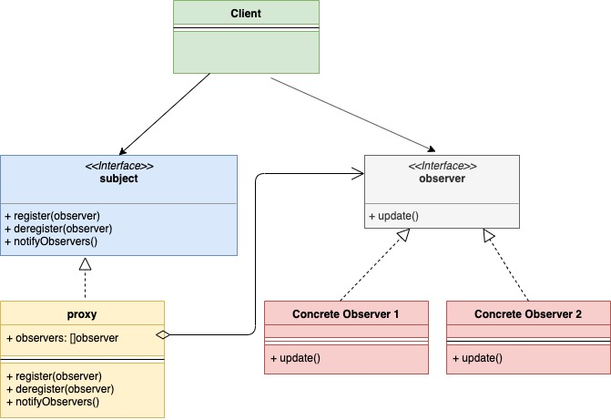
Observer - Usage
For example, the physics code(subject) has all the gaming-related aspects. The achievement system registers itself so that whenever the physics code sends a notification, the achievement system receives it. Based on the conditions, it unlocks the proper achievement with associated and it does all of this with no involvement from the physics code.

Slide 10

Observer - Pitfalls
Observers are slower than a statically dispatched call, but the cost is minute expect when performance is extremely critical.
Since the observer pattern is synchronous, where the subject directly invokes the observers, the subject doesn't resume its work until all observers return from their methods. This could lead to a case where a slow observer blocks the subject from continuing its work. To avoid this, the slow work has to be pushed onto another work queue or thread.

Slide 11

Singleton - Situation
Sometimes a class cannot perform correctly if there are multiple instances of it because we need to have idea on what previous instances are doing for the current instance to be implemented correctly. Thats were singleton comes into play it only has one instance of a class globally that we can use whenever we want to use that class. This way whenever we use an instance we can have previous information on when the instance was used.

Slide 12
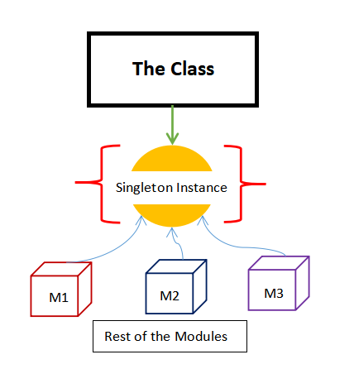
Singleton - Usage
Creating a single instance of a class and proving a global access point to it so that any system can use the class without creating it own instance.
Some features:
It doesn’t create an instance when no one uses it: this will save memory and CPU cycles.
It’s initialized at run time: It’s initialized only when used unlike static variables which are initialized even before calling the main function.

Slide 13

Sample Code
class FileSystem
{
public:
static FileSystem& instance()
{
static FileSystem *instance = new FileSystem();
return *instance;
}
private:
FileSystem() {}
The static instance_ member holds an instance of the class, and the private constructor ensures that it is the only one.
instance() method grants access to the instance from anywhere in the codebase.

Slide 14


Singleton - Pitfalls
They make it harder to reason about code:
If we are trying to understand a code. If the function does not touch
any global variables then we can easily get a grasp of what is going on.
But lets for example imagine that there is a global variable being used.
To figure out what’s going on with the variable we need to hunt the
entire code base just to find out one bad call that’s setting a static variable
to wrong value.
They aren’t concurrency-friendly:
Games these days generally run on multi core CPUs. When we create a global variable every thread will have access to that and they can make changes to this critical section. This can lead to deadlocks, race conditions and other synchronisation bugs.

Slide 15
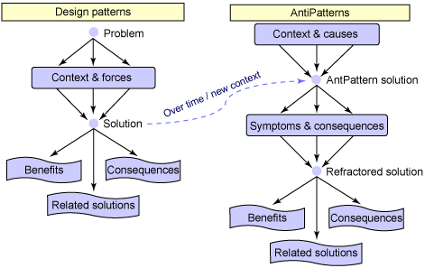
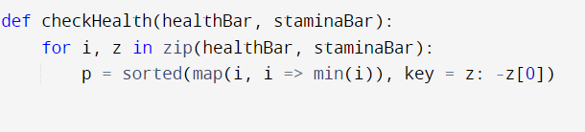
AntiPattern - Premature/Speculative Optimization
Unnecessary optimization of non performance critical code can make the code unreadable/unmaintainable and fixing bugs in large gaming applications is never easy!
Especially if the order of run time complexity doesn’t change, micro optimizations are not of significant benefit when dealing with modern game frameworks. If a O(n) algorithm stays O(n) it’s probably not worth it.

Slide 16
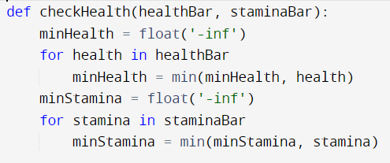
Resolution
Attempting to optimize prior to having empirical data is likely to end up increasing code complexity and room for bugs with negligible improvements.
Profile at every step! If there is no discernable memory or time improvement, do not make speculative code optimizations.

Slide 17

AntiPattern - Once
If a method needs to be called only once, but accidentally gets invoked again dynamically through reflection, it can cause misbehaviour
Game engine behaviour can sometimes be unpredictable and debugging can be difficult when time is of the essence.
Special functions have to be executed only once in the current load file or game’s instance.

Slide 18

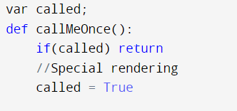
Resolution
Use a helper function to check if the function has been accessed previously
Implementing a standardized check for such methods will help in preventing this. Additional checks need to be implemented for multi-threading gaming apps.

Slide 19
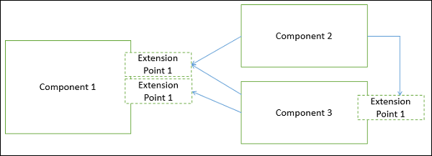
Modern object oriented techniques in the gaming industry
Considering the amount of effort it takes to implement game logic in game development, it is essential to find an efficient way to do that. Using software design patterns is considered good practice but the patterns have to be applied with a reason and caution. It is often tempting to over-complicate design and implementation, which, in result, puts the success of a product at risk
Component-based architecture focuses on the decomposition of the design into individual functional or logical components that represent well-defined communication interfaces containing methods, events, and properties. It provides a higher level of abstraction and divides the problem into sub-problems, each associated with component partitions
Unity3d coding approach follows a component-based design

Slide 20
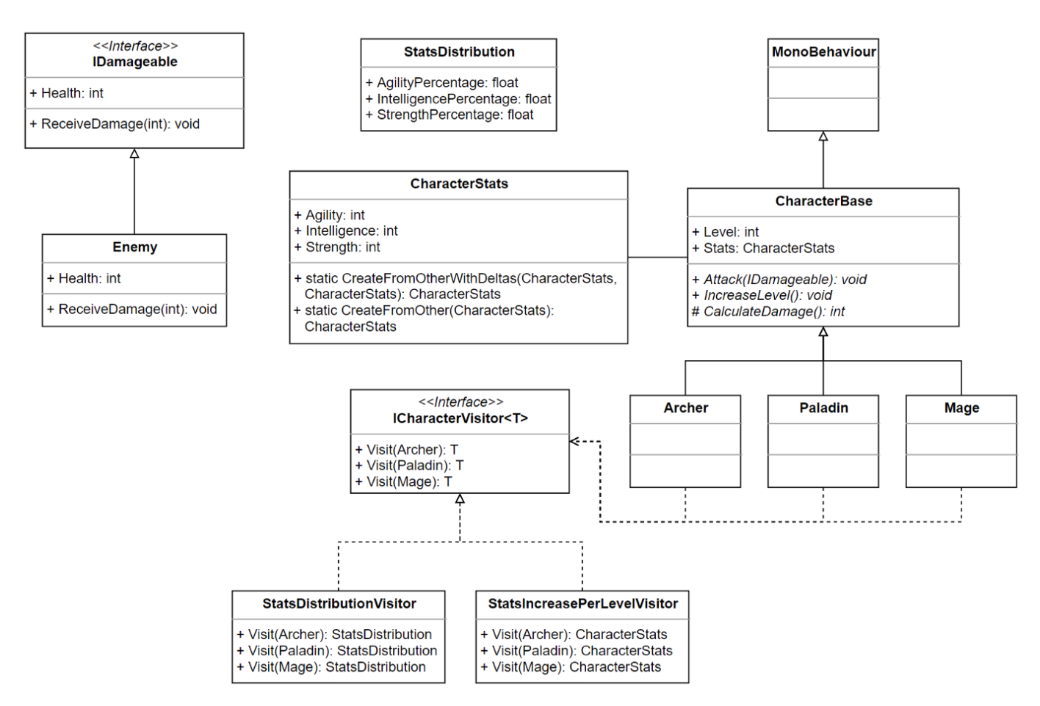
Modern object oriented techniques in the gaming industry
It is quite challenging to follow object-oriented principles in games developed in today's day and age. Especially given the current engines and dev kits, the architecture works against you.
However, there still exists situations where certain isolated components can be tackled using common best practices.
The visitor pattern is useful in scenarios when we have to deal with multiple objects of the same structure that have to implement certain operations. Visitor lets us keep related operations together by defining them in one class. This opens additional opportunities to make use of the reach feature set of the engine when we want to influence the data of the visitor classes
20

